Slide 1

Point of Care Testing
Rosanna W Peeling
Professor and Chair, Diagnostic Research
Director, International Diagnostics Centre
London School of Hygiene & Tropical Medicine
www.idx-dx.org

Slide 2
Point-of-care Diagnostics
Need for point of care (POC) testing for STIs
Lessons learnt from implementation of POC testing
Dare to dream:
  novel multiplex POC tests and data connectivity
  AMR POCT
Summary

Slide 3
Point-of-care Diagnostics
I have no conflicts of Interest to declare
Mention of company products does not imply endorsement by the London School of Hygiene & Tropical Medicine

Slide 4
Role of Diagnostics in
Patient Management
Incubation
Symptoms
Treatment
Screening e.g. HIV, Syphilis, CT/GC
Determine risk of disease e.g. HPV
Rule in/out an infection e.g. Chlamydia
Determine drug susceptibility e.g. Gc
Initiate treatment e.g. CD4 for ART
Treatment monitoring e.g. HIV Viral Load
Test of Cure e.g. Gc

Slide 5
ASSURED Tests for improving
Access to STI testing
A = Affordable
S = Sensitive
S = Specific
U = User-friendly
R = Rapid and robust
E = Equipment-free
D = Deliverable
Affordable
Accurate
Accessible

Slide 6
The Rapid Test Paradox 1999
Goal of Study: to determine the situation in which a rapid test might be more cost-effective and treat more infections than laboratory based tests
Study design: A decision analysis framework was used to compare a rapid test with a lab based test - PCR assay, for screening women; variables include:
- prevalence; test sensitivity and specificity,
- probability of developing pelvic inflammatory disease (PID)
- likelihood that patients will wait for the rapid test results or return to the
clinic for treatment
Results:
- A rapid test with a sensitivity of 65% treated more cases of infection than PCR (sensitivity of 90%) if the return rate was <65%
  - By the time they return, 3% of patients had already developed PID
Gift at al. STD 26:232-40, 1999

Slide 7
FDA Approval in 2012:
OraSure HIV Test
A risk-benefit model showed that in the first year of use:
~ 4,500 new HIV infections identified among those not aware of their HIV status
~ 2,700,000 who would test negative
~4,000 transmissions would be averted, outweighing the individual risk of ~1,100 false negative results
The product would need to have clear messages on the implications of test results

Slide 8
Systematic Reviews of the Performance of
STI POC Tests (Sex Transm Inf Dec 2017)
Syphilis Rapid Treponemal Tests:
Tucker et al 2011: 15 studies included 22,000 patients
Median sensitivity: 86% (interquartile range 0·75–0·94)
Median specificity: 99% (interquartile range 0.98–0.99)
Yafari et al 2013: 25 studies
Pooled Sensitivity = serum: 84%; whole blood: 80%
Pooled Specificity = serum: 96%; whole blood: 98%
Chlamydia trachomatis:
Kelly H, et al. STI 2017: 11 studies 11,889 patients: Pooled sensitivity:
Vaginal swab: 37% (95% CI: 22.9 - 52.9%)
Endocervical swab: 53% (95% CI: 34.7 - 70.8%)
Nesseria gonrrhoeae:
Guy RJ, et al. STI 2017:
endocervical swab: range: 12.5 -70%; Vaginal swab: 54% (95% CI: 37-71%)

Slide 9
Point-of-care Diagnostics
Need for point of care (POC) testing for STIs?
Lessons learnt from implementation of POC testing
Dare to dream: can we improve POC testing if we have better POC tests?
Summary

Slide 10
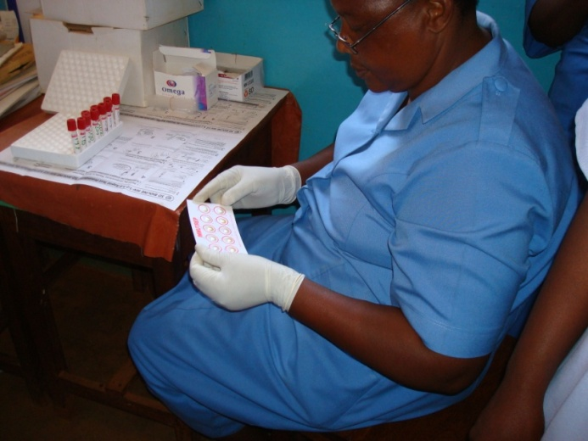
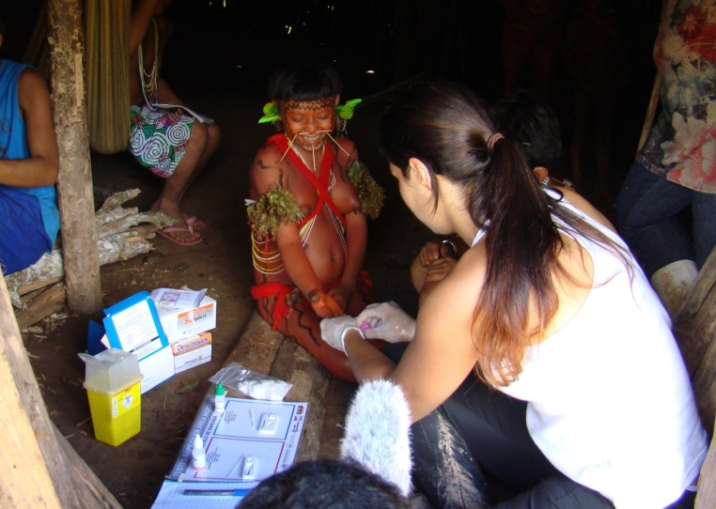
Point-of-Care Testing Lessons Learnt 1:
Feasible to use in all settings
Success depends on:
Engage authorities and all stakeholders
Dissipate tensions between providers, meet, discuss and identify champions
Train according to the needs and guide by baseline and follow up information
Provide monitoring, supervision, support, and recognition
Share results and discuss actions together
Consult and get feedback from users
Integrate with other services such as with HIV testing
Garcı´a PJ, et al. (2013) Rapid Syphilis Tests as Catalysts for Health Systems Strengthening: A Case Study from Peru. PLoS ONE 8(6): e66905

Slide 11
POC Testing Lessons Learnt 2: Catalyst for Health System Strengthening (e.g. PERU Cisne Project)
Number of times going to HC
Activity
Number of days spent
1st Contact
Filling out documents
(ANC service)
- Anti-tetanus vaccine
1
2nd y 3rd
Contact
Processing of Social security insurance
8
Aproximately . 27 days have passed between the time when the patient came for the first time until the time when the patient received treatment
4th Contact
ANC service – paper work for lab tests
1
5th Contact
Laboratory – sampling
Use of venous blood for HIV RT
2
ANC – tests results provided
Pen G not available in ANC services
Partners not treated
No monitoring of patients in treatment
6th Contact
15
27 days
Mabey et al. PLoS Med 2012;9:e1001233.
Garcia P et al. PLoS One 2013;8:e66905

Slide 12
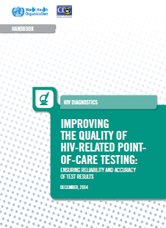
POC Testing Lessons Learnt 3: Quality Assurance must be part of the POC testing budget
Transport and storage
Start-up training and supplies
Healthcare Provider Training
Supervision and refresher training
External quality assurance
Laboratory monitoring
Procurement of consumables
Procurement of cartridges
Notes:
SERGIO
We want to know what does it cost to fund a quality assured POC program… In working with LSHTM economists and modelers and using data provided by countries, we costed many of the steps in implementing qualtiy assured POCT using activities as described in the WHO/CDC Handbook. This figure shows how procurement of cartridges is the major contributor of cost wth start up training and supplies being the second largest percentage.... A similar exercise was done for malaria RDTS and preliminary datafro this exercise als shows that EQA is approx 15 -25% of the total cost of testing.

Slide 13
POC Testing Lessons Learnt 4:
Funding and Architecture

Slide 14
Point-of-care Diagnostics
Need for point of care (POC) testing for STIs?
Lessons learnt from implementation of POC testing
Dare to dream: can we improve POC testing if we have better POC tests?
Summary

Slide 15
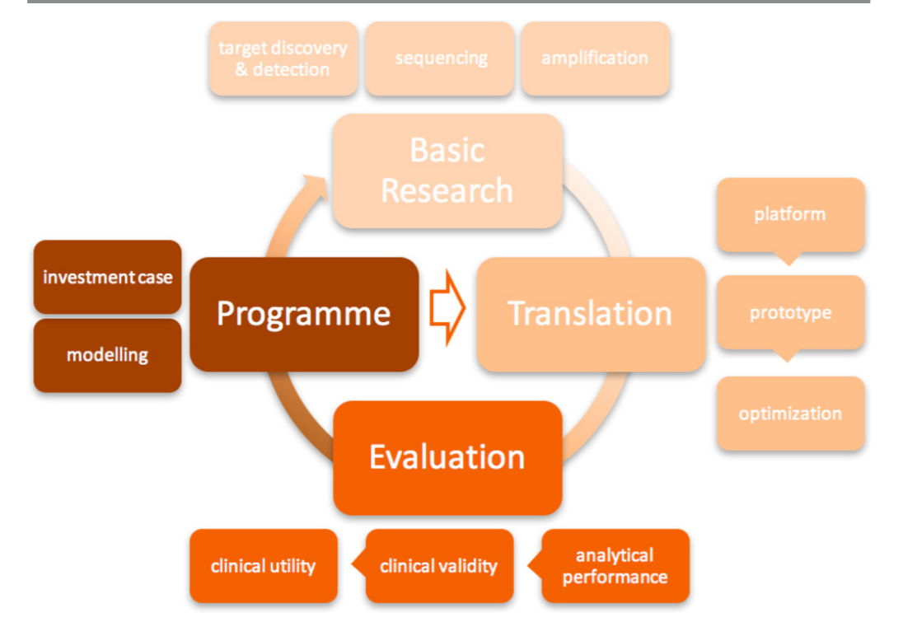
WHO RHR: STI POC Initiative
Toskin I et al. Advancing point of care diagnostics for the control and prevention of STIs: the way forward. Sex Transm Infect 2017;93:S81–S88.

Slide 16
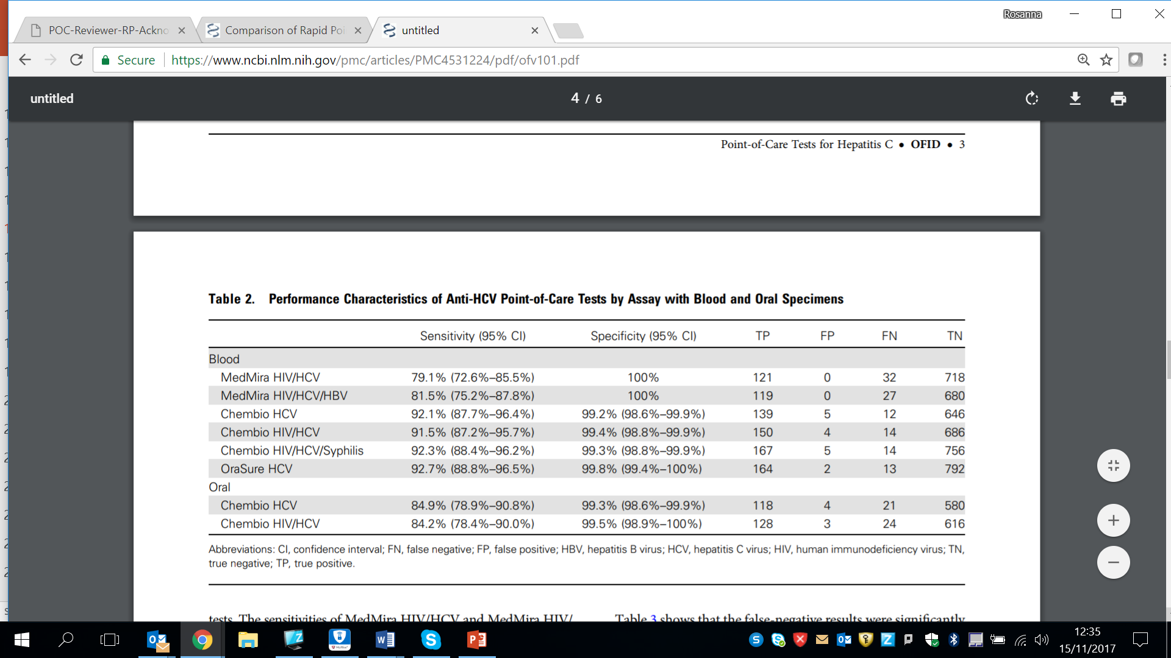
Performance of Multiplex Tests
Reader available for ChemBio tests
Fisher DG, et al. Open Forum Infect Dis. 2015 Jul 7;2(3):ofv101. doi: 10.1093/ofid/ofv101.

Slide 17
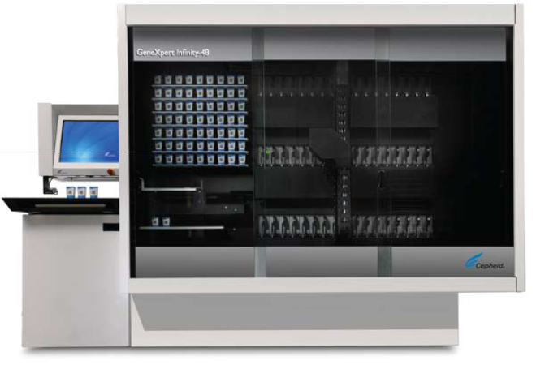
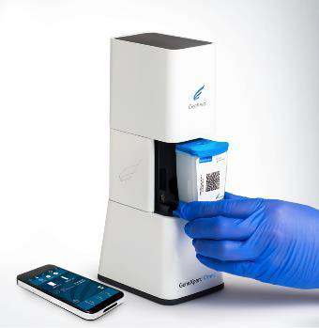
Ongoing evolution of POC Testing in models of more client-friendly STI Services
Crowdsourcing for means of promoting uptake of syphilis testing in MSM in China and Hep testing worldwide
Ref: Tucker JD, Fenton KA. Lancet HIV, 2018, 5: e113
eSexual Health Clinic system
Ref. Estcourt CS et al. Lancet 2017 2:e182-190
Dean Street Express Clinic model:
Rapid anonymous STI testing
Ref: Whitlock et al. Int J STD AIDS Oct 2017
HIV viral load, early infant diagnosis, HCV, CT/Ng, HPV, Trichomonas
MTB/RIF, Flu A, B/RSV, MRSA,
C. difficile, Norovirus, Group B Strep

Slide 18
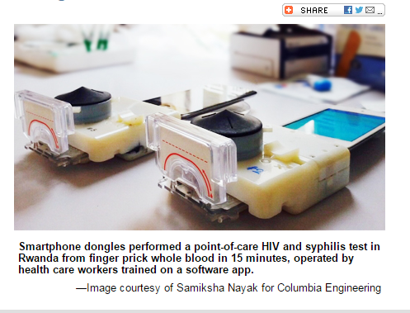
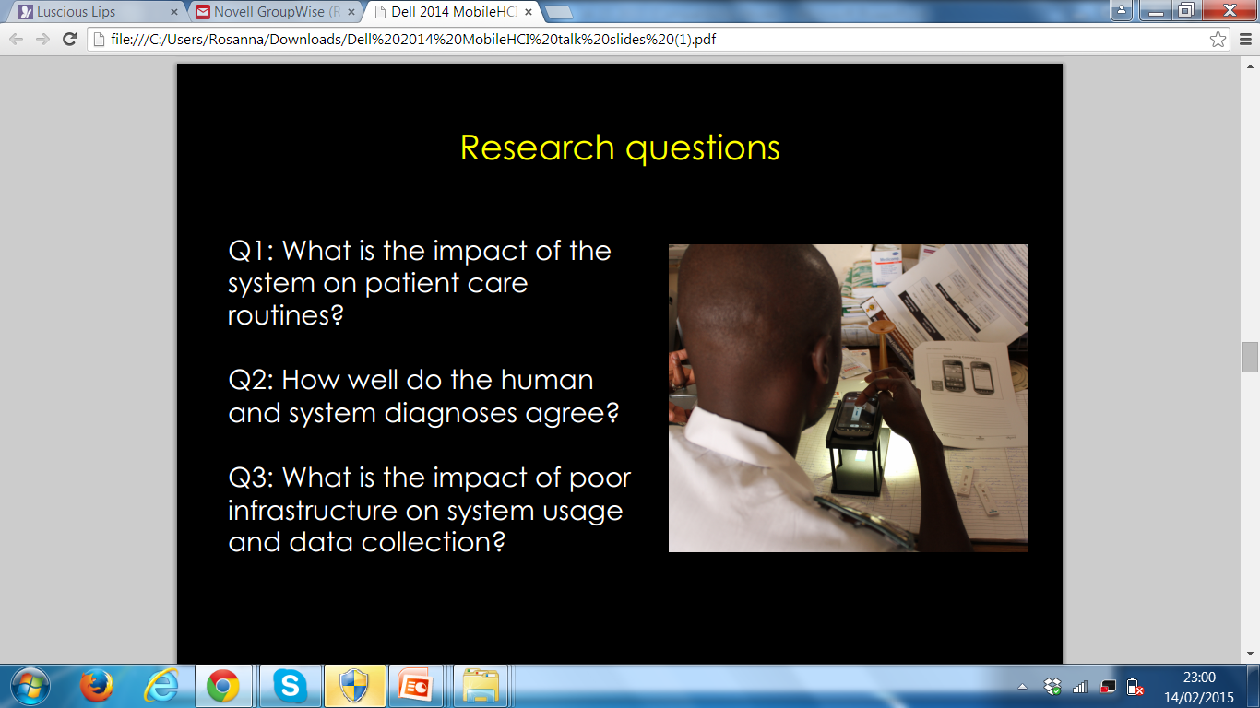
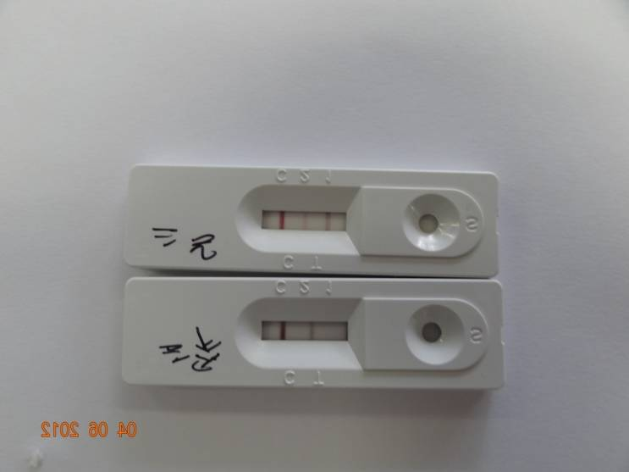
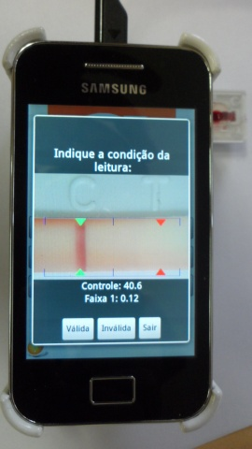
Smart Phone based Diagnostics

Slide 19
Convergence of Technologies: an opportunity for automated surveillance
1
Quality Assurance, especially for POCTs
2
Patient treatment
Connectivity
3
Public health monitoring
4
Outbreak response
5
LI(M)S interfacing
With connectivity we can turn data into intelligence for real-time surveillance and to improve supply chain management and improve the quality of patient care
6
Stock management
7
Operator performance; Instrument performance

Slide 20
Connectivity Dashboards
Monitoring Error Rates:
Monitoring stock/supplies:
purchase
purchase
Laboratories or POC Testing sites
Months
Gous et al. Expert Rev Mol Med 2018

Slide 21
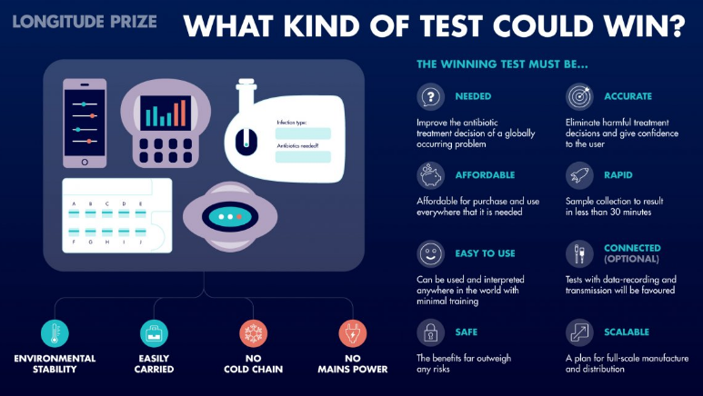
Dare to Dream AMR POCT:
In 2014, UK conducted a modelling study which found that:
- if an AMR POCT for ciprofloxacin resistance was available, 66% of the 33, 431 ceftriaxone
treatments given annually to individuals with NG could be replaced by ciprofloxacin;
  - If an AMR POCT for penicillin resistance was available, 79% of ceftriaxone treatments
  could be substituted with penicillin
  AMR POCT can reduce loss to follow up, extend the life of our current last-line treatment, and is cost-saving

Slide 22
Summary
Point-of-care testing can reduce loss to follow up and increase the yield of infected patients diagnosed and treated
Lessons learnt from implementing POC testing:
  Success: importance of implementation science and champions;
  catalyse health system strengthening and improve patient outcomes
  Challenges: quality assurance, funding and architecture for sustainability
POC testing in the near future:
  Sample in-answer out molecular testing for CT/NG can be used to offer more client friendly STI services
  Multiplex molecular/serology technologies with data connectivity can offer testing efficiencies and automated surveillance
An AMR POCT for rapid detection of NG and susceptibility pattern or genetic resistance markers will allow providers to go back to using older regimens with considerable cost-savings

Slide 23

Thank you
LSHTM/IDC: Helen Kelly, Maurine Murtagh, Ben Cheng, Debra Boeras, Catherine Wedderburn, Freddy Bates, David Mabey
Kirby Institute, Australia: Rebecca Guy, Louise Causer
McGill University: Nitika Pai
Orebro University, Sweden: Magnus Unemo
UCLA, USA: Jeff Klausner
Verona University, Italy: Anna Azzini, Massimo Mirandola
WHO: Igor Toskin, Melanie Taylor
Funding: Bill & Melinda Gates Foundation, UNITAID and WHO

